Slide 1
Southern Arizona Aquatics Association (SAAA) 2022
Stroke & Turn Officials Clinic

Slide 2
Goal of this Clinic
Get you ready to officiate an SAAA Swim Meet:
    Making DQ calls
    Stroke Briefing

Slide 3
You Should Know
The Rules: Read the Rules Book and learn the infractions & what specific rules were violated.
Positions on-deck: where you stand on-deck
Jurisdiction: area of the pool you officiate
Balance: the idea that every swimmer is officiated equally, no more, no less attention
Wrap: going to the side of the start or turn end to see all lanes at once (e.g., at the start of backstroke)
Protocols: How to observe & How to make a DQ call

Slide 4
Before the Meet
Arrive at least 30 minutes before the meet start
  45 minutes, if attending Coaches Meeting
  Report to Lead Official
  In uniform & ready to go
Radio ready: Check batteries & channel
In position on-deck 5 minutes before start

Slide 5
Coaches Meeting
Before warm-up begins.
Include officials, coaches and captains.
Determine if there are any exhibition heats.
Review suit and tape rules/management/penalties.
Offer to talk directly with each team, if coaches wish.
Ask for “Questions ?”

Slide 6
Position & Protocol
If alone, you should walk the pool side during the swim at feet of swimmer group.
  If with partner – walk both sides
  Or one stands at start and one at turn end in middle of lanes
  Remain there even if only 1 swimmer.
Stand 2-3 steps back from edge of pool; relaxed hands at sides.
Step forward to edge of pool when swimmers are in your jurisdiction (AZ 3-Step):
  Observe, do NOT inspect
  Stand erect, do not lean, hands in back
  No “dancing” – you might get a little wet!
  No papers/sheets in hand.

Slide 7
Jurisdiction
The area of the pool you “officiate”
Your area is usually a section of the pool, divided by
  Lanes: 1-4, 5-7, and 6-10.
  Halves of pool: start half and turn half of the pool.
  Or by end: last stroke in, first stroke out.
  Know terms:
    Lead/lag, and tag team (walking the sides)
    Wall to wall (walking the sides)
    15m Mark (free, back and butterfly)
    Last stroke in- first stroke out (Turn Judge)

Slide 8
Balanced Officiating
Every swimmer is officiated equally
  Stay in your position whether 1 or 4 swimmers in your jurisdiction
  Relay take-offs
  “Mirror” your counterpart official
  Note: Some pool configurations or sun glare may require “special” positioning.

Slide 9
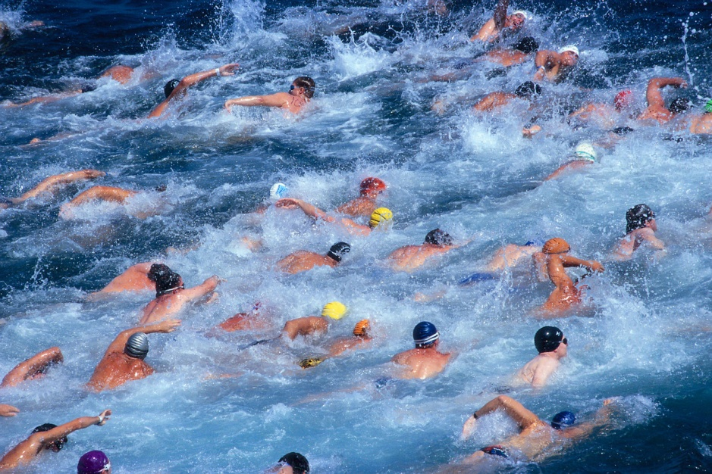
The Strokes Briefly
Read the Rules Book
Best way to learn is on-deck, working with an experienced stroke & turn official
Refining our S&T officiating is a never-ending process

Slide 10
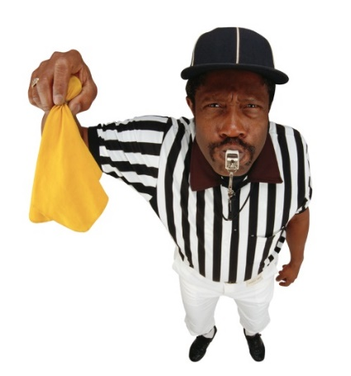
Making a DQ Call
Raise open hand, hold it up till you’re acknowledged.
Press radio PTT, wait 1 second and announce:
  “This is “Brian”, Turn end, Possible call, Lane #___” then let go of button and wait….
When acknowledged, drop hand and say “Brian”, Lane #, Infraction (nothing more).
    If asked, describe what you saw
    Don’t use your hands.
Wait for Referee to accept or overturn.
Start-end judge notifies swimmer

Slide 11
The Golden Rule
Ensure fairness to all swimmers
The swimmer gets the benefit of doubt, always!!!

Slide 12
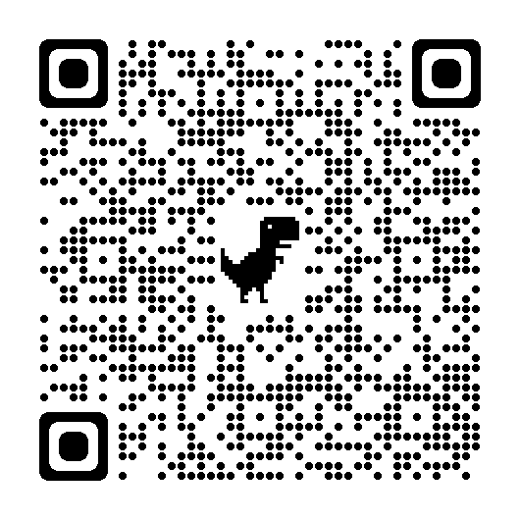
Available Resources
USA Swimming https://www.usaswimming.org/
Rule book PDF
SAAA swimsaaa.org
SAAA Vice President Colin Cordell
colintcordell@gmail.com 520-730-3606

Slide 13
A Quick Review of the Basics

Slide 14
Attitude
Professionalism is expected of all officials!
Know the USA swimming Rules Book and keep a copy with you at all meets.
Maintain a calm, respectful demeanor
Control the competition and venue without being overbearing.
Always be approachable.
Impartiality: Don’t “hang” with one team.

Slide 15
Uniform
Respectable, clean & professional.
Uniform:
  White, collared, short sleeve shirts tucked in
  Navy shorts/ pants/skirts (ladies only, please)
  White shoes (preferred)
  Cap or Visor (highly recommended).
Walkie-Talkie radios with headset. (SAAA provides)
Whistle (if you are refferee).
Other: Lotion, water.

Slide 16
Uniform/Suit Violations
If on deck, notify (require change to a conforming suit before swim)
If on blocks after whistle, swim & DQ
Suit violations - Best handled during warm-ups.
  Referee tactfully informs the swimmer’s coach.
  Require change to a conforming suit before next swim.

Slide 17
The Tape Rule
No adhesives: No kinesio tape; requires prior approval of meet referee No band-aids (they come loose/off)
Medical tape OK for broken finger, diver’s brace. Cover bleeding wound.
No compressives: rubber or elastic sleeves/wraps

Slide 18
Blood
Blood is a NO-NO at meets.
Deal with any blood immediately
  May delay start of race, reasonably.
  Stop an ongoing race immediately, except if 4th swimmer in relay.
  Disinfect the deck, etc.
  Send the swimmer off deck; cannot return until bleeding is stopped, cleaned & covered.
  Referee decides if re-entry is allowed.
  No shaving at the meet

Slide 19
Concussion
Swimmer displays symptoms, signs or behaviors consistent with a concussion
  Loss of consciousness, headache, dizziness, confusion, balance problem, etc.
  Remove swimmer immediately from the meet

Slide 20
A Note About Coaches
Do not be surprised when they protest a call in a “novel” way; it’s not personal.
  Many are new to swim coaching and some may just be getting to know the rules.
  It’s their job to be advocates for their swimmers
  Remain calm and non-confrontational.
  Offer to do a stroke briefing for them before meet.
  DQ clarifications, if the coach wants, should always come from the Referee.

Slide 21
Points of Emphasis
Lightening & Thunder Guidelines:
  Suspend activities when lightning is at 10 miles from pool.
  Evacuate pool and surrounding deck; many indoor facilities are grounded.
  Do not resume activities until 30 minutes lapse after last sound/sighting.
Uniforms must be of decent appearance, including suit coverage.
  Meet referee should contact coach (not swimmer) and request that the uniform meet standards.
Deck-changing will result in exclusion from the rest of the meet.
The final leg of the individual medley and the medley relay requires the swimmer to be at or past vertical toward the breast before they initiate any stroke, kick or propulsive motion.
Jewelry is permitted; wearing of medical alerts is encouraged, need not be taped to body.

Slide 22
The Golden Rule
Ensure fairness to all swimmers
The swimmer gets the benefit of doubt, always!!!

Slide 23
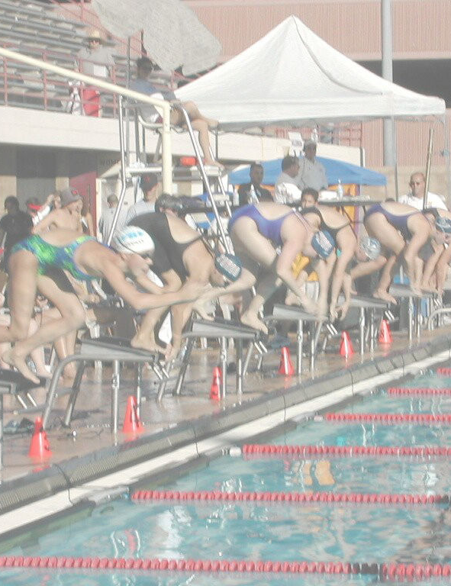
Stroke Briefing or
Training Film

Slide 24
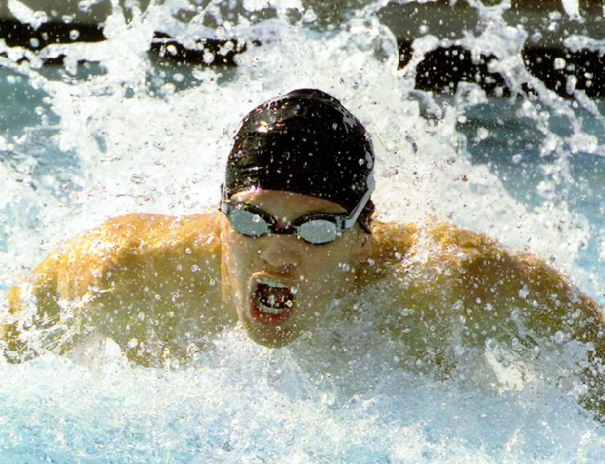
Questions and Discussion

Slide 25
Thank you
for helping the kids

Slide 26
The Golden Rule
Ensure fairness to all swimmers
The swimmer gets the benefit of doubt, always!!!

Slide 27
The Referee or Lead Official
You are the one person who is responsible for the quality of the meet.
Maintain a calm demeanor and defuse any volatile situations.
You must know and follow the rules, set a proper positive, respectful tone with all.
Answer questions when you know the answer, but you don’t have to know everything !!!
If you don’t know, say “I’ll get back to you”, then research before getting back to them.

Slide 28
Referee & Starter Detail Review

Slide 29
The Referee – Before the Meet
Arrive at least 15 minutes before warm-up.
Check the equipment: flags, lane lines, blocks, etc. timing system., sound system.
Identify Admin people and your on-deck officials.
Conduct a pre-meet coaches meeting Conduct short officials meeting (at SAAA events this is conducted by us.
  Give deck Assignments: positions, jurisdictions, relay T/O’s
  Review DQ and stroke protocols
  Set 2-way radio channel

Slide 30
The Referee – During the Meet
You set the pace of the events:
Blow short whistles (prepare to swim) after swimmers exit the pool…unless doing flyover starts.
Then check the next race’s starting field for correct number of swimmers in proper lanes
Blow long whistle, (closes the heat) after all the last heat’s swimmers clear the pool, signaling next race swimmers to get on the blocks, edge of deck, or in the pool
  Blow a second long whistle on backstroke races to request swimmers to move to the wall and set their feet.
Either hand-over the field immediately to an experienced starter who will settle them, or settle them yourself, then hand-over
Watch the start and silently note any false starts in writing. Usually circle the lane number on a program

Slide 31
The Starter
Before the meet:
  Check the starting blocks, starting system operation and speaker volume
  Participate in the Coaches meeting with the Referee
  Conduct a Test Start to check the timing system check with ADMIN at invitational and championship meets
  During the meet:
    Tell the Referee your preferred deck position (for optimal view of entire field)
  Check field for correct number of athletes in proper lanes
  Have microphone raised when long whistle sounds
  First, ensure that field is settled: PATIENCE, PATIENCE

Slide 32
A Good Starter
You are every swimmer’s guardian.
Be conscious of any outside interference
Practice PATIENCE, PATIENCE, PATIENCE
When the starting field is settled, say “Take Your Mark” in a level, calm, inviting voice
May use the word “PLEASE” when giving any command /instruction other than “Take your mark”
Press the start signal only after all swimmers have assumed a stationary (set) position

Slide 33
False Start Protocol
If a swimmer starts before the starting signal, the starter should “Stand” the rest of the field, then recommend to the referee, who will decide if a False Start is warranted
After the start: If you observe a swimmer started before the signal, the race shall continue without recall, and you note in writing the lane of the offending swimmer
You advise the referee of a “possible false start”
You and the referee compare written notes without talking. If your marked lane numbers match, the referee confirms a false start and implements the protocol for handling the DQ

Slide 34
Situations
What would YOU do
in these real meet situations ?

Slide 35
Situation ??
As you give the starting signal, you, see lanes 6, 7 and 8 swimmers leave before the signal was given.
Starter, what do you do ?

Slide 36
Situation ??
You blow the long whistle and all swimmers get on the blocks except lane 5, who is
  running to get there and jumps up late
  discussing something with the timer before jumping-up late
Referee, what do you do ?

Slide 37
Situation ??
A swimmer walks-up to the referee, saying he missed his heat because he counted heats wrong, asking to be put-in.
Referee, what do you do ?

Slide 38
Situation ??
Between the consolation and championship finals, a swimmer in lane 7 withdraws from the 50 breast Final by declaring a false start.
Is this OK ? What do you do ?

Slide 39
Situation ??
A breaststroker sculls with his hands at the end of the underwater pull.
Is this legal?

Slide 40
Situation ?
An IM swimmer in lane 8 finishes his breaststroke, and leaves the wall past vertical towards his back. He is DQ’d.
Do you accept the DQ call ?

Slide 41
Situation ??
After being called to the blocks for the 200 Free Relay, the swimmers decide to reverse their order of swim
Is this legal ?

Slide 42
Situation ??
A backstroker passes under the turn end flags, rotates towards her stomach, then glides and kicks into the turn wall.
Do you accept the DQ call ?

Slide 43
Situation ??
A breastroker’s feet, after each breaststroke kick, break the water together in an upward movement.
Is this a DQ ?

Slide 44
Situation ??
A turn judge reports the swimmer in lane 5 had a one-hand touch, the right hand touching 1” in front of the left.
Do you accept the DQ call ?

Slide 45
Situation ??
A turn judge reports the backstroke swimmer in lane 3 was “submerged at the finish.”
Referee, do you accept the DQ call ? What can you ask ?

Slide 46
Situation ??
Since there is only one swimmer, in lane 1, the turn end judge for lanes 1-4 moves over to lane 1 to get a better view.
Any problem ?

Slide 47
Situation ??
During the backstroke turn the lane 3 swimmer while underwater enters lane 4 accidentally, but gets back in his lane before surfacing, without interfering with that swimmer.
Is there a call ?

Slide 48
The Golden Rule
Ensure fairness to all swimmers
The swimmer gets the benefit of doubt, always!!!

